Slide 1
Smart Rods (Hardware)
Mattin Mir-Tahmasebi
Supervisior: Prof. Constantinides
Notes:
Going to talk about:
My name is Mattin, my project was to improve educational tools used in primary school mathematics classrooms
Going to explain what is currently wrong and how we aimed to improve upon it, talk about different possible designs, what went well (and not so well) during the process, and will hopefully end with a video demonstration of the product made.

Slide 2
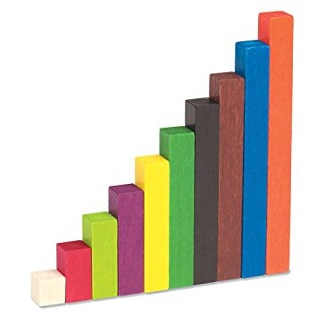


Cuisenaire rOds
2 + 8 = 10
0.2 + 0.8 = 1
4 + 6 = 10
0.4 + 0.6 = 1
Notes:
What are Cuisenaire rods?
Number bonds to 10
Are not associated with numerals so can extend to other units eg. Decimals. Concepts before notation.

Slide 3
Project Aims
Record and track student progress
Save time currently wasted on administration
Notes:
Problems with the rods that the project tries to solve:
- Difficult to keep track of the entire class, knowing who is struggling/excelling. The product should record work and discern this information
Teachers have to record proof of their students’ work – since the rods do not involve any writing, there is no proof, so at the end of the lesson, the children have to write what they did. This wasted time could be spent learning.

Slide 4
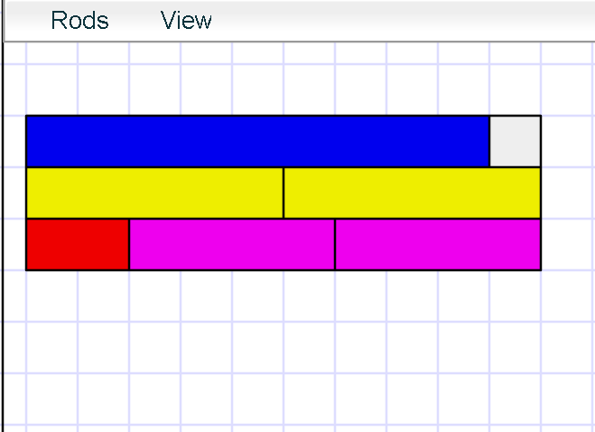
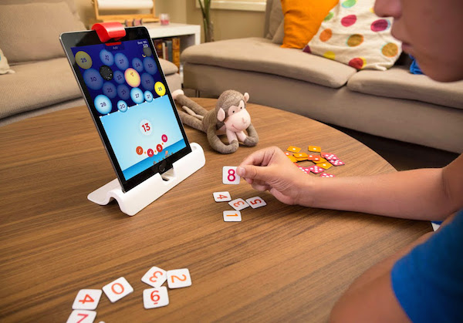
Existing products
Virtual Cuisenaire Rod Environments
Osmo Numbers
Notes:
No similar existing products – no precedent means higher chance of failure when trying new ideas
Most existing products were software tools - research shows manipulatives help connect exercises to real world problems
One relatively similar product: osmo. Uses physical objects read by camera into app, but in our product we want the focus to be the rods not a screen.

Slide 5

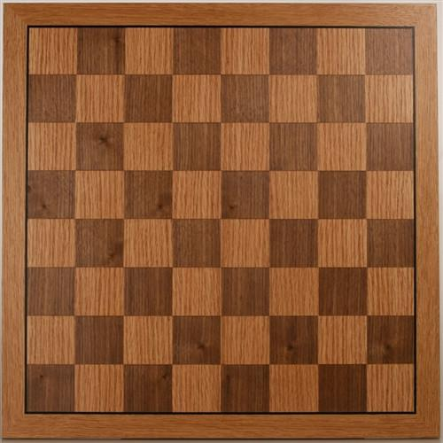
Where should the electronics go?
In the rods?
Too small
Power-hungry
Expensive
Many units to charge
Easily misplaced
In a playing board
Can contain all circuitry
Fits a large battery
Cheaper
One unit to charge
Hard to lose

Slide 6

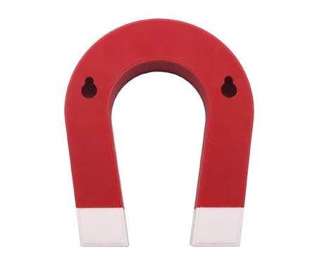
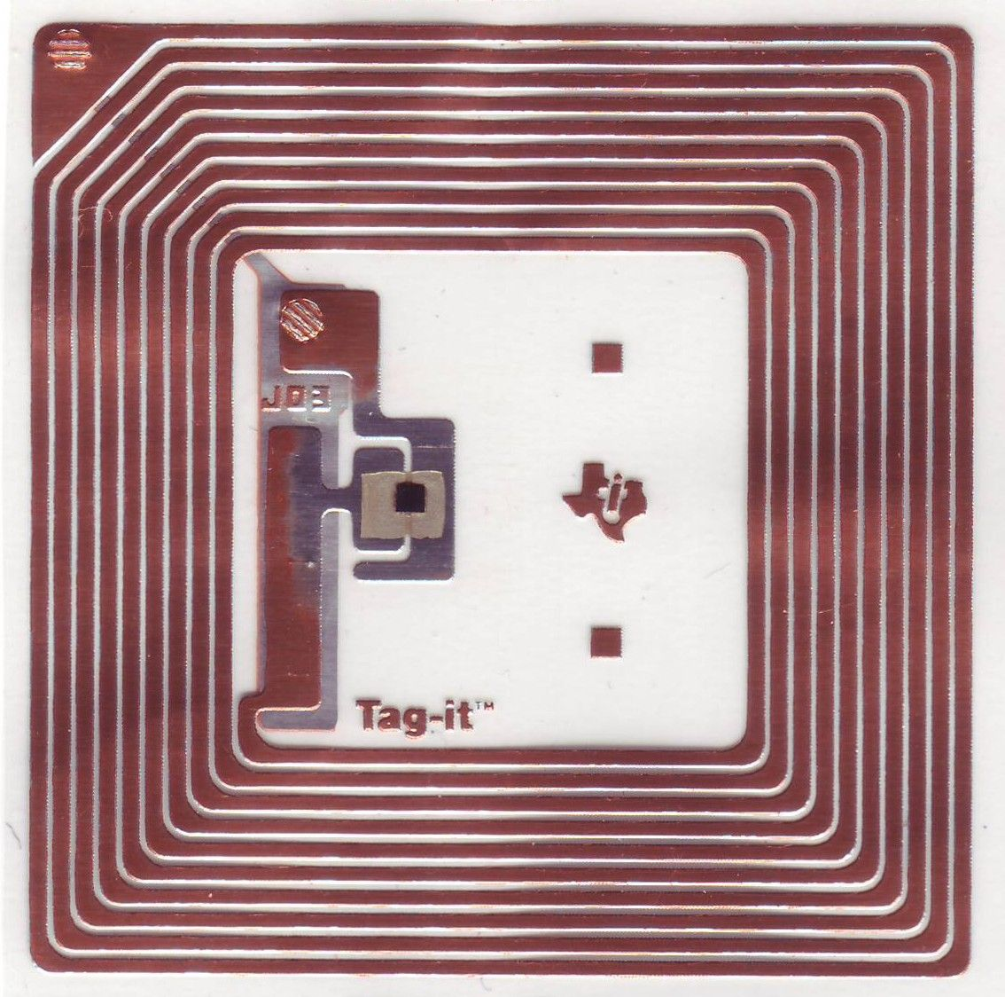

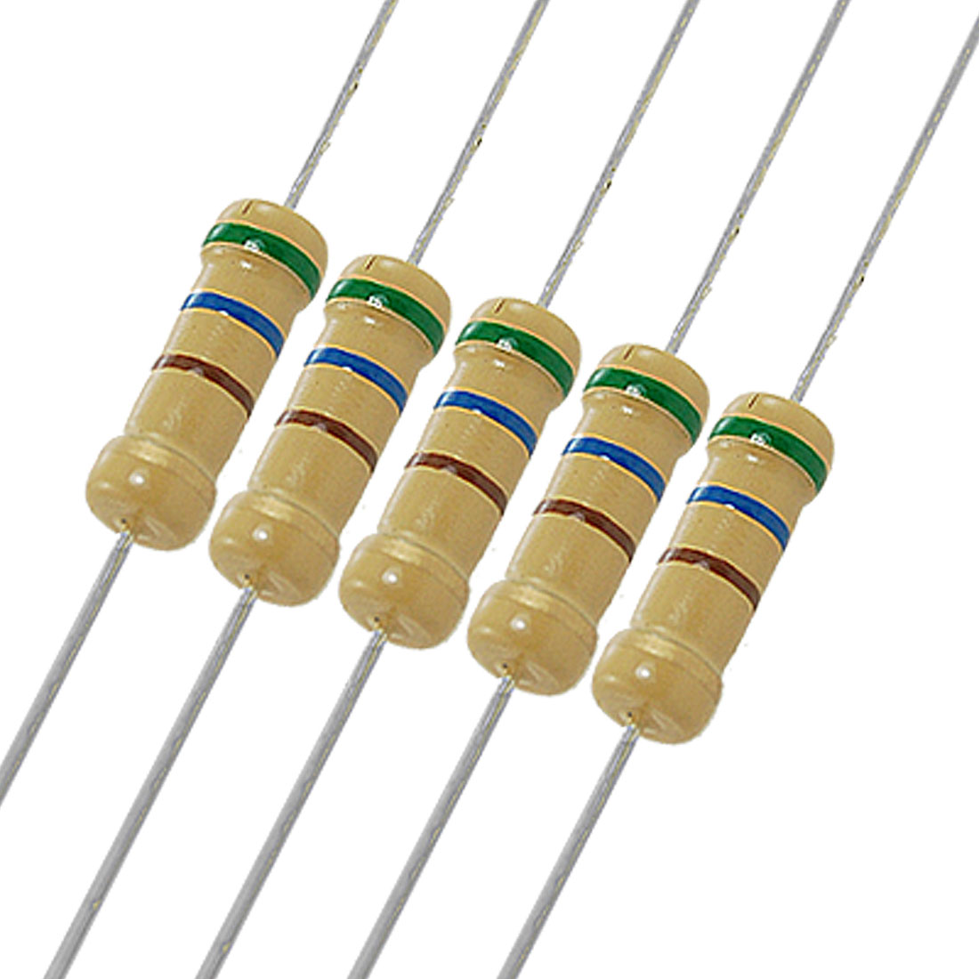
How to detect rod positions
 | Weight | Magnetic Fields | RFID | RGB Light | Resistor Chains
Reliability
Cost
Power Usage
Rod Complexity
Notes:
Important criteria were…
Weighted rods, weight sensors on board
Magnets in rods, hall-effect sensors in board
Passive RFID chip in rods, rfid readers in board
Different coloured rods, RGB sensors in board
Conductive material in rod, to short out chains of resistors in board
Resistors were the best.

Slide 7
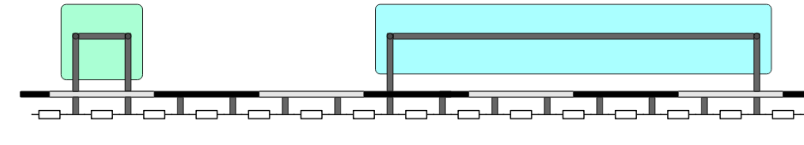
Shorting Resistor Chains
5.0V
4.4V
4.4V
3.6V
2.9V
2.1V
1.4V
0.7V
0.7V
0.7V
0.7V
0.7V
0.7V
0.7V
0.7V
0V

Slide 8
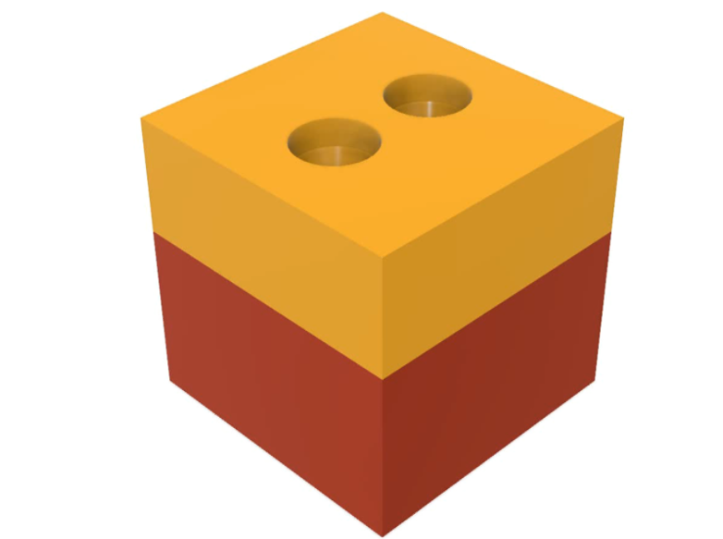
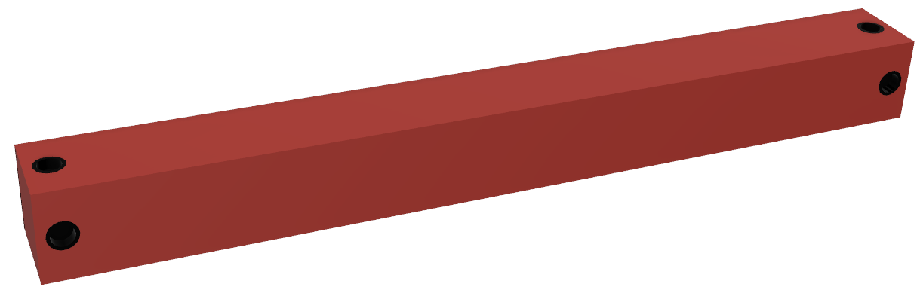
Conductive MAterial
Conductive 3D Printing Filament
Wire embedded in rod

Slide 9
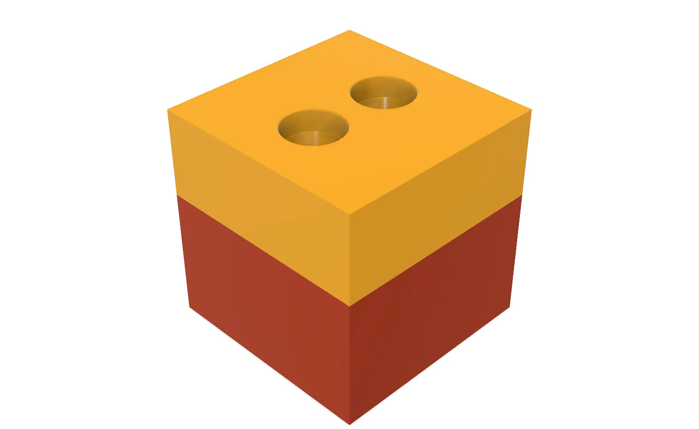

Slide 10
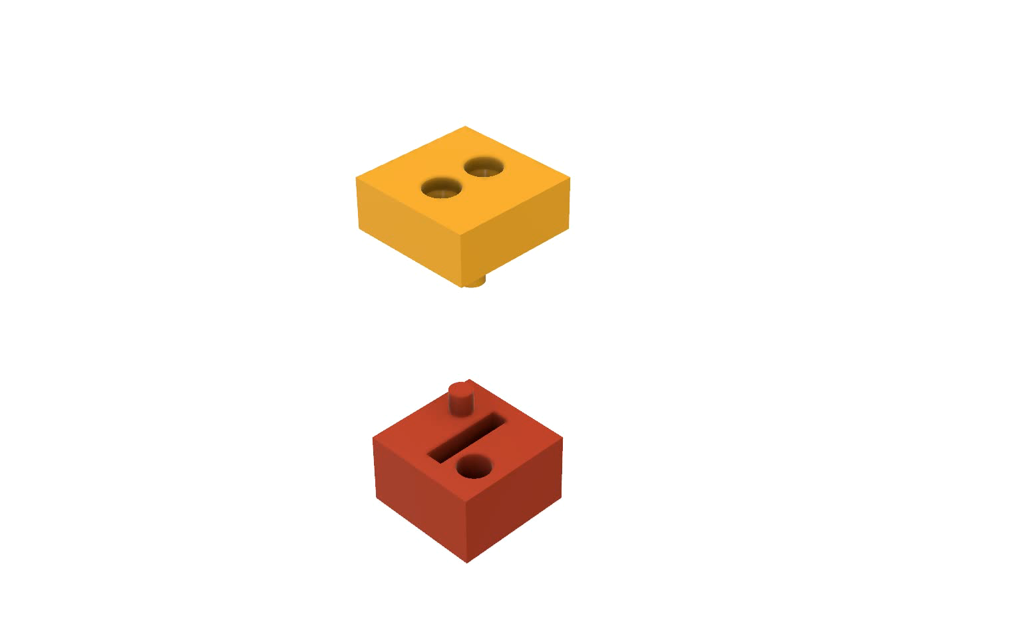

Slide 11
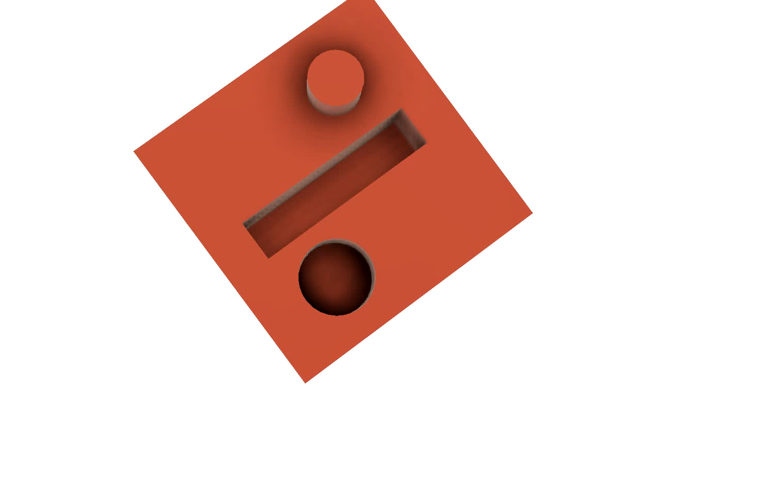

Slide 12
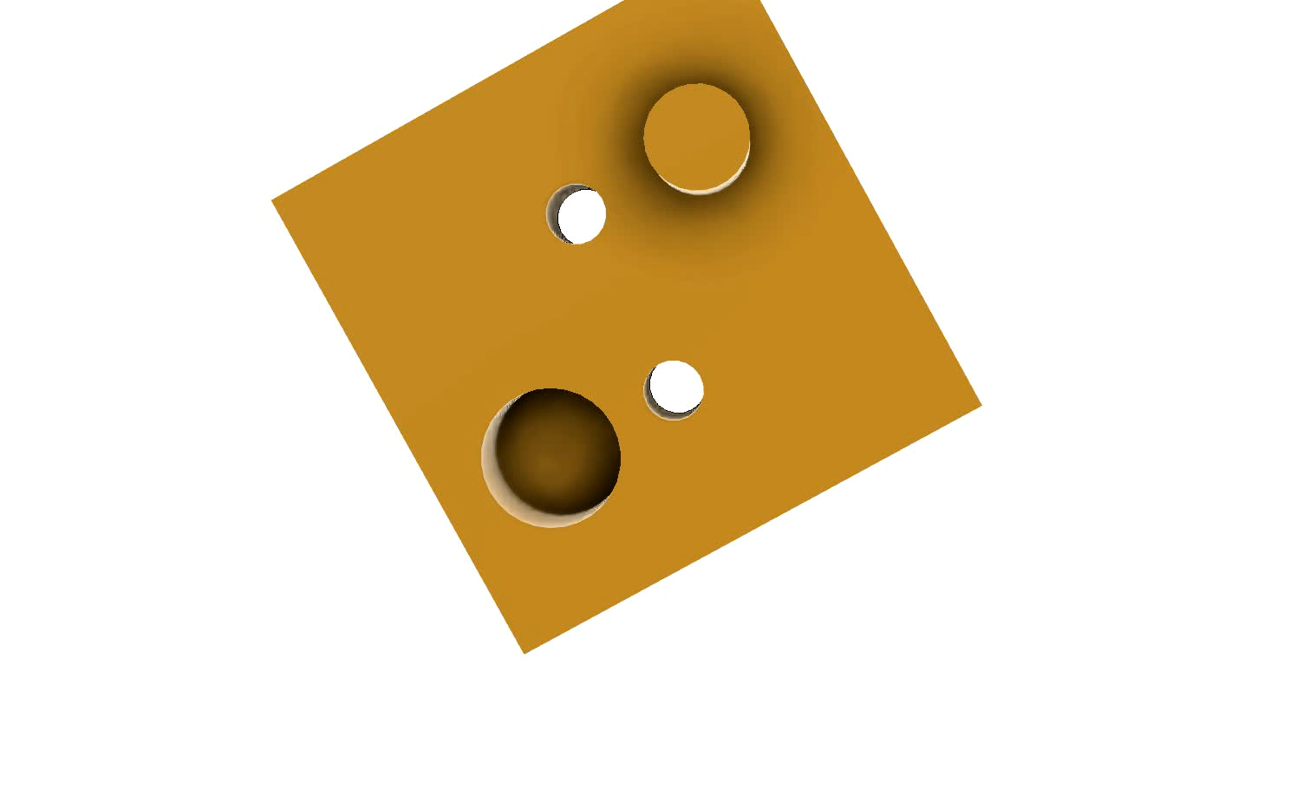

Slide 13
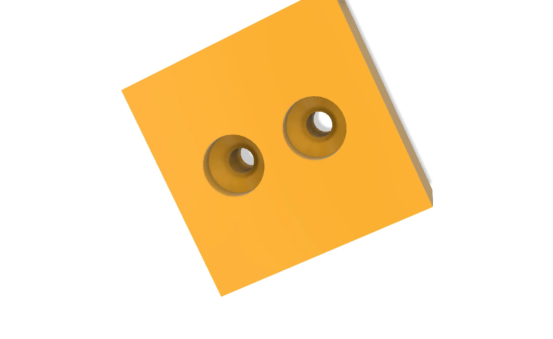

Slide 14
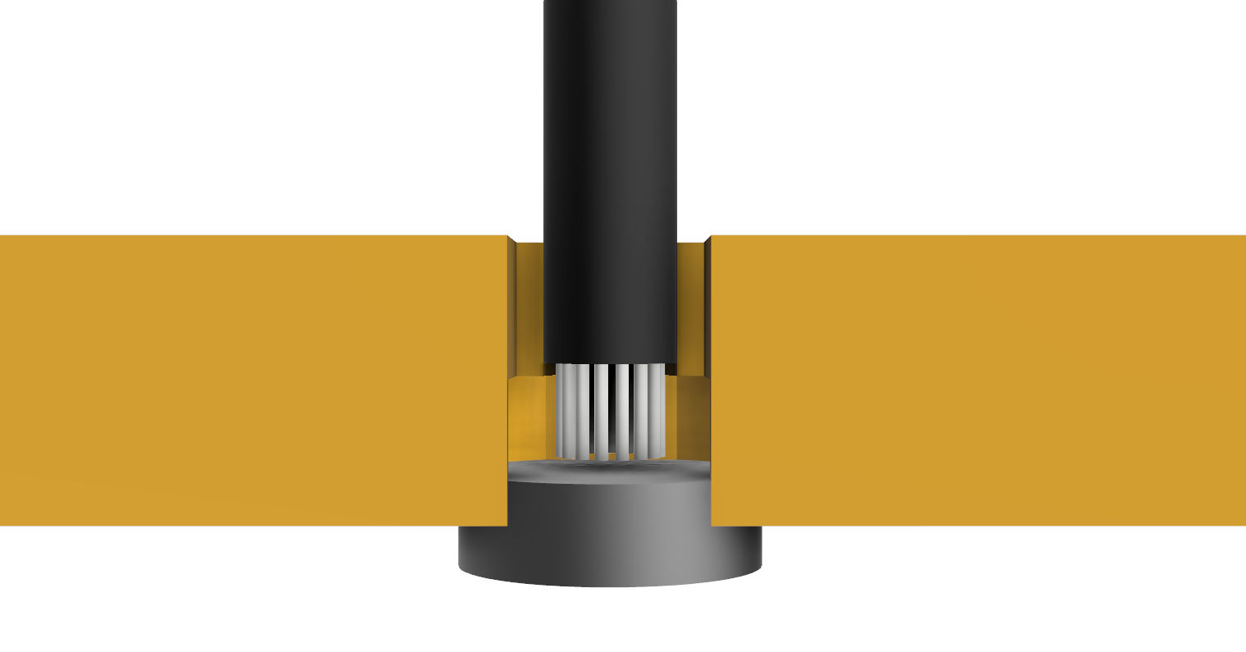
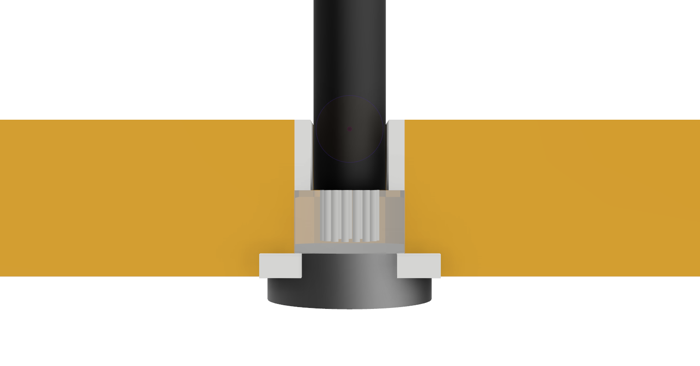
Magnetic Electrical Contact
Silver Paint as an adhesive
Conductive Epoxy
Silver paint as a cavity filler
Notes:
Can’t Solder magnets

Slide 15
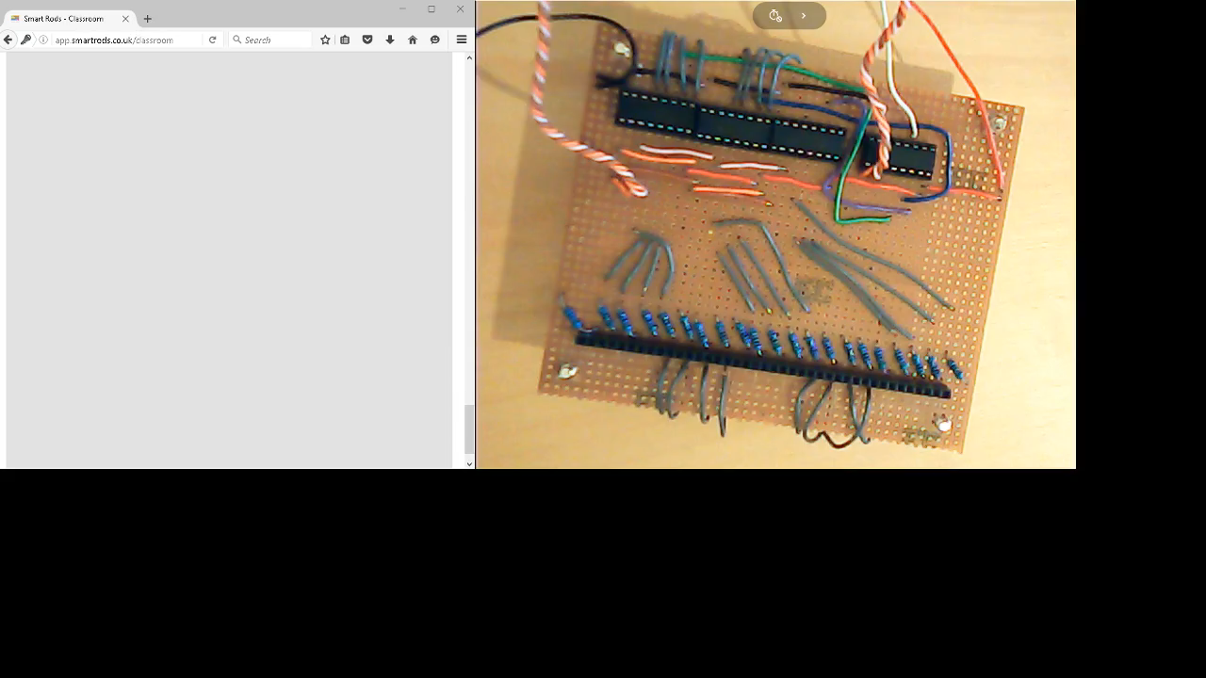
Video Demonstration

Slide 16
Image Sources
Slide 2: Rods – Amazon.co.uk
Slide 4: Osmo – PlayOsmo.com
Slide 5: Chess board – ChessHouse.com

